Slide 1
Java Essentials

Slide 2
Prerequisites
Object Oriented Programming Concepts
Knowledge of C programming
Basic Understanding of Computer Architecture

Slide 3
Unit Objectives
Title : Stepping towards OOPs
On completion of unit-1 you will be able to:
1. Write and run Java program.
2. Understand the difference between structured & Object oriented Programming.
3. Use primitive data-types, variables & operators.
4. Understand and use type conversion and casting.
5. Use control structures & flow control.
6. Use strings and arrays.

Slide 4
Introduction to Java

Slide 5
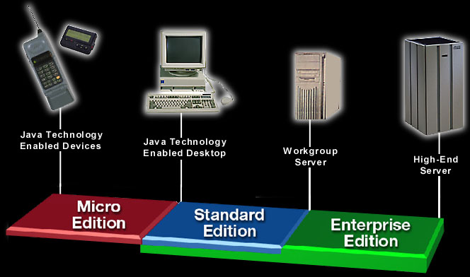
Java 2 Platform

Slide 6
J2EE Framework
JDBC
Browser
HTML, XML
Data
any
http
server
Servlet
or
JSP
HOME
Entity
Bean
HTTP
REMOTE
Device
RMI/IIOP
JDBC
Security
Containers
Session
Bean
Transactions
Concurrency
Context
EJB Server
JVM
any OS

Slide 7
What is Java?
Java is
  A Programming language
  A development environment
  A deployment environment
Similar in syntax to C++; similar in semantics to Smalltalk
Used for developing both applets and applications

Slide 8
Primary Goals
Provide an interpreted environment for
  Improved Speed of development
  Code portability
  Code reusability
Enable users to run more than one thread of activity
Support dynamically changing programs during runtime
Furnish better security

Slide 9
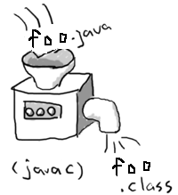
Java Compiler
Translates java programs into Java class file (byte codes).
Also performs strong type checking, prevents access violations etc.
Most common Java compilers are:
    javac (Sun Microsystems)
    jikes (IBM’s open source compiler)
    ECJ (Eclipse compiler for Java)

Slide 10
ByteCodes
The majority of type checking is done when the code is compiled
Code that maintain proper type discipline form the Bytecode
Every SunTM approved implementation of the JVM must be able to run any compliant class file.

Slide 11
Java Virtual Machine
Reads and executes compiled byte codes which are platform independent
Is platform dependent and provides hardware platform specifications
Is implemented as software
Is implemented in a Java technology development tool or a Web browser
Facilitates Garbage Collection, Exception Handling etc.

Slide 12
Java Virtual Machine…
JVM provides definitions for the
  Instruction set (CPU)
  Class file format
  Stack
  Garbage-collection
  Memory management

Slide 13

Development and Execution Infrastructure
File Name:
“Foo.java”
Class Foo{
.
.
…main(..){
}
}
Compiler
2. Compile It
1. Write a Program
Source files
(Java Language)
Input
Output
Virtual
Machine
3. Execute It
Linux
Intermediate
Files(Intermediate Language)
Virtual
Machine
File Name
“Foo.class”
Input
Mac OS X
Output
Virtual
Machine
Windows

Slide 14
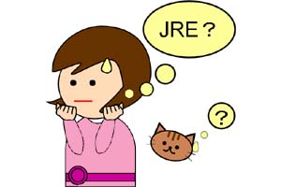
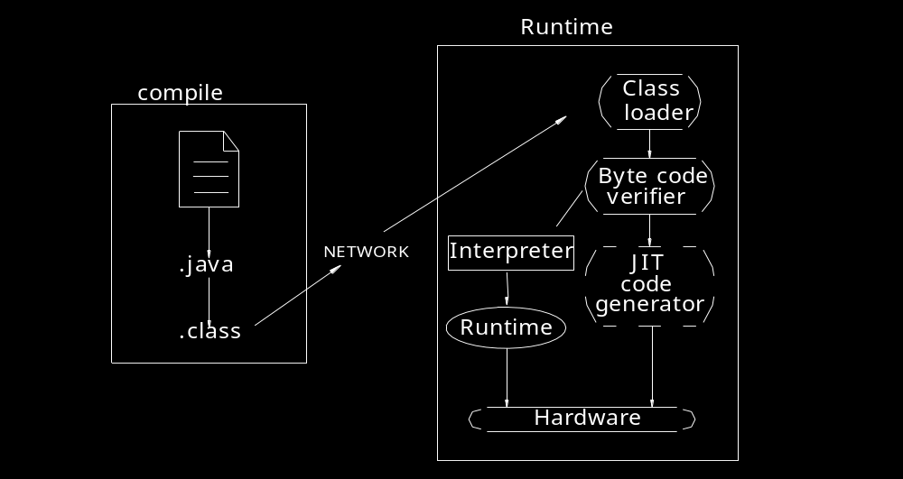
Java Runtime Environment
Loading code
Verifying code
Executing code

Slide 15
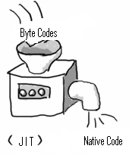
Java Just-In-Time Compiler (JIT)
Converts a part of the bytecode to native code.
Requires more memory because both bytecode and the corresponding native code are in memory at the same time.

Slide 16
Garbage Collection
Is the process of automatically freeing objects that are no longer referenced by the program
Is performed in Java by a program called Garbage Collector
Is done automatically
Can vary dramatically across JVM implementations

Slide 17
Installing and configuring JDK

Slide 18
Installation Instructions
Download the latest version of the J2SDK software
http://java.sun.com/j2se/1.4.2/download.html
Read the installation notes
http://java.sun.com/j2se/1.4.2/install.html
Run the installation setup file

Slide 19
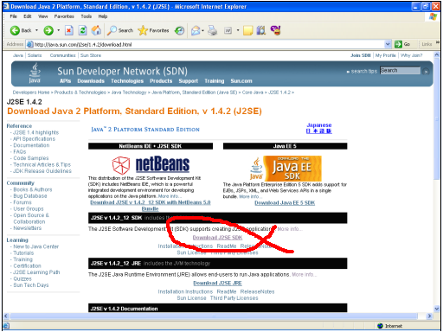
Installation..

Slide 20
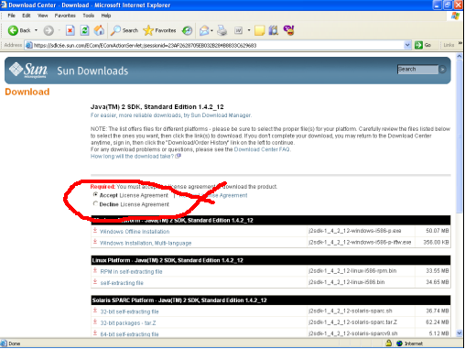
Installation…

Slide 21
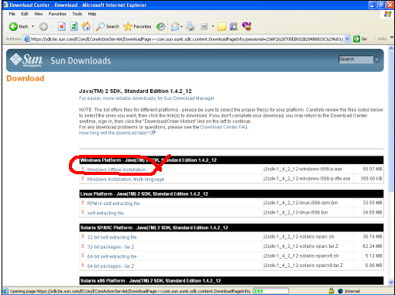
Installation….

Slide 22
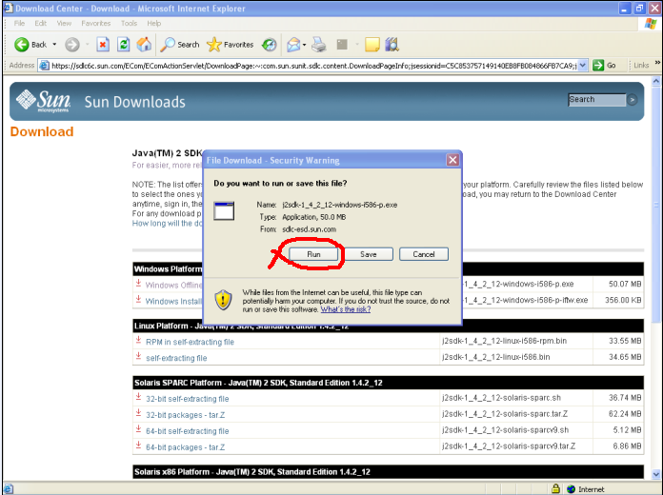
Installation…..

Slide 23
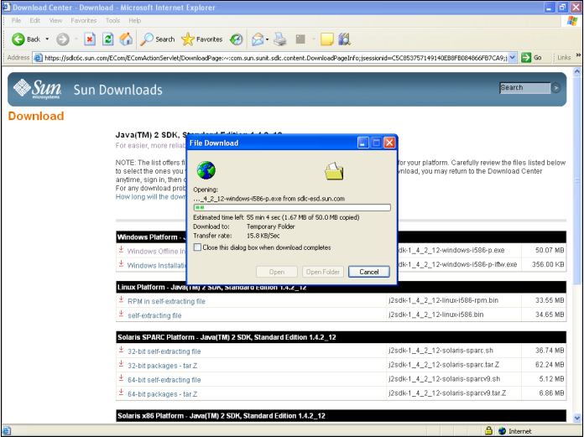
Installation…..

Slide 24
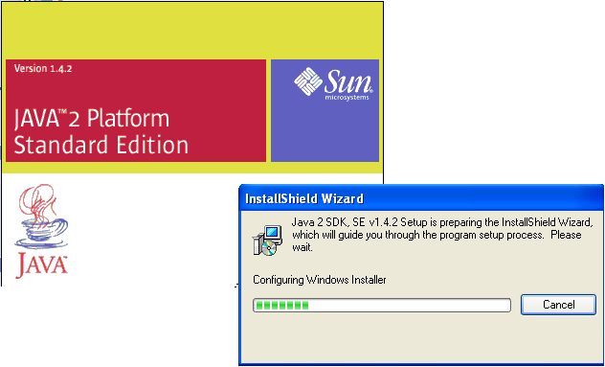
Installation…..

Slide 25
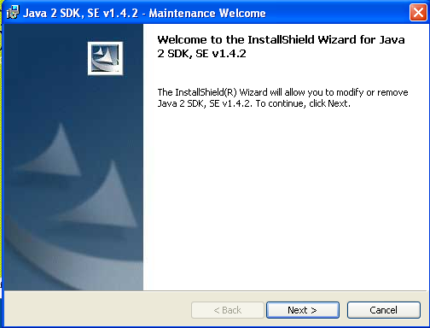
Installation…..

Slide 26
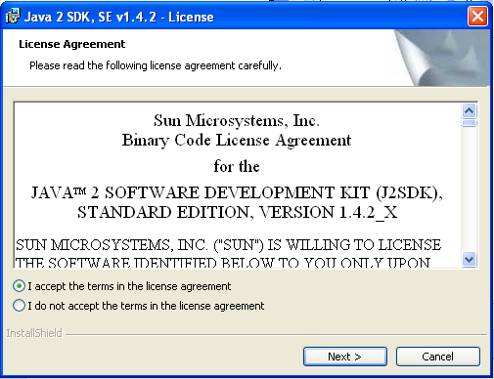
Installation…..

Slide 27
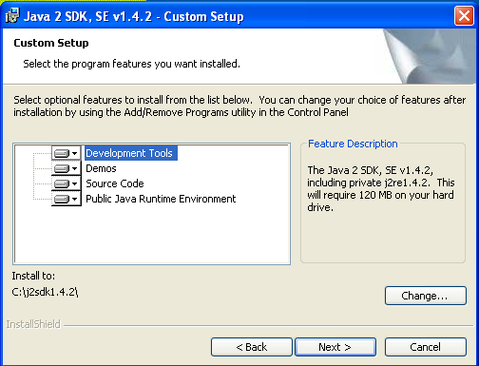
Installation…..

Slide 28
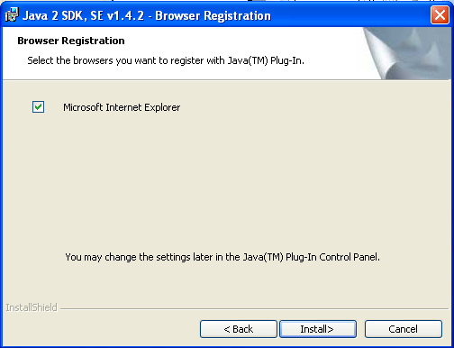
Installation…..

Slide 29
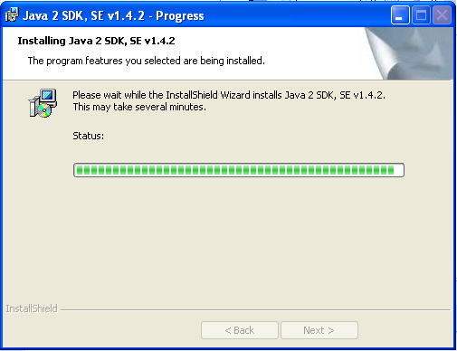
Installation…..

Slide 30
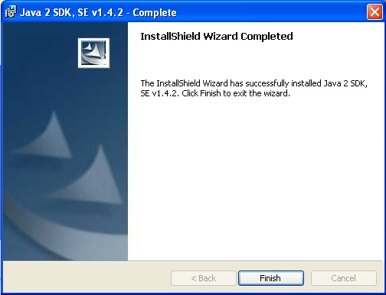
Installation…..

Slide 31
Configuring
Set path & classpath
C:\set JAVA_HOME=c:\j2sdk1.4.2
C:\set path=JAVA_HOME/bin;%path%
C:\set classpath=<JAVA_HOME>/lib/tools.jar;.;

Slide 32
Stepping towards OOPs

Slide 33
Hello world Program
//HelloJava.java
class HelloJava {
public static void main(String[] args) {
System.out.println(“Hello World”);
}
}
Compilation:
C:\javac HelloJava.java
Running your first java program:
C:\java HelloJava

Slide 34
Introduction to OOPs
Object Oriented Programming
  Components:
    Classes
    Object
    Method
  Features:
    Encapsulation
    Abstraction
    Generalization/Inheritance
    Polymorphism

Slide 35
Class
All object have state and behavior i.e. a particular structure. It is defined by classes
Is also know as a blue print of an Object
State is shown by value/s held by variable in a class
Method in a class exhibits the behavior of a class

Slide 36


Object
All real world objects have two things:
  State
  Behavior
For example:
  Men have state (name, color, height, weight) and behavior (run, eat, sleep).
  Cars have state (current gear, current speed, number of gears) and
  behavior (accelerate, slow down, change gear).

Slide 37
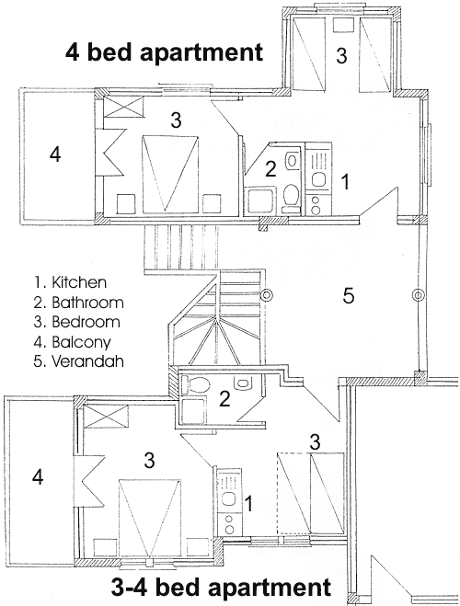
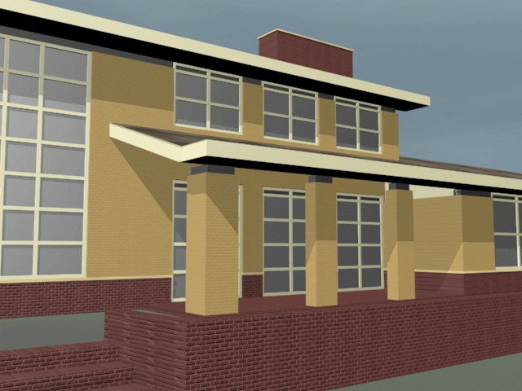
Class & Object
Class is a blueprint of an object

Slide 38
Example of class
class Cat {
int speed;
void move(int s) {
speed = s;
}
void stop() {
speed = 0;
}
}
//here class is a keyword and Cat is the name of the class having variable speed and methods move() & stop.

Slide 39

Example of an Object
An object is an instance of a class.
It provides the physical existence to the variables
declared in the class.
The new operator dynamically allocates memory (that is, allocates at run time) for an object and returns a reference.
Cat tom
=
new Cat();
speed
move()
stop()
tom

Slide 40
Parts of an Object
Properties
State
Methods
Constructors
Destructors

Slide 41



Properties & State
Chasing
Driving
Sleeping
chasing = {true / false}
driving = {true / false}
sleeping = {true / false}

Slide 42
Methods
Privately
Accessible
Method
chaseJerry()
sleep()
Public
Accessible
Method
drive()
Object tom

Slide 43


Abstraction
How these machines would work we don’t know but how to use this is known to us.

Slide 44
Encapsulation
Encapsulation is the mechanism that binds together code and the data it manipulates, and keeps both safe from outside Interference and misuse.
Methods
accelerate(int speed);
changeGear(int gear);
Properties
gear
speed
color

Slide 45
Stepping towards OOPs
A ‘C’ program showing working of a car and driver.
Ref Example:1.1.1
Java version of the above program.
Ref Example:1.1.2

Slide 46
Java Language Fundamentals

Slide 47
Identifiers & Literals
An identifier (name) must begin with a letter, a dollar sign ($) or an underscore character (_). Subsequent characters may be letters, $, _ or digits.
Classes, methods and variables cannot have Java Keywords as Identifiers (names).
true, false and null are literals (not keywords), but they can’t be used as identifiers as well.
const and goto are reserved keywords, but not used. Therefore cannot be used as identifiers / literals.

Slide 48
Primitive Data Types and Variables
Data Type | Size (bits) | Type | Signed | Initial Value | Min Value | Max Value
boolean | 1 | N/A | N/A | false | false | True
byte | 8 | Integer | ✓ | 0 | -128(-2⁷) | 127 (2⁷ – 1)
short | 16 | Integer | ✓ | 0 | -2¹⁵ | 2¹⁵ – 1
char | 16 | Single Unicode Character | ✗ | ‘\u0000’ | ‘\u0000’ (0) | ‘\uFFFF’ (2¹⁶ – 1)
int | 32 | Integer | ✓ | 0 | -2³¹ | 2³¹ – 1
long | 64 | Integer | ✓ | 0L | -2⁶³ | 2⁶³ – 1
float | 32 | Floating Point Number | ✓ | 0.0F | 1.4E-45 | 3.4028235E38
double | 64 | Floating Point Number | ✓ | 0.0 | 4.9E-324 | 1.7976931348623157E308
Ref Example :1.2.1 Ref Example: 1.2.2

Slide 49
Primitive Data Types and Variables . . .
Variable
Two types of variables: Member & Automatic
Member variables
  Accessible anywhere in the class.
  Automatically get initialized before invoking any
  constructor.
  Static variables are initialized at class load time.
  Can have the same name as the class.
Automatic variables (method local)
  Must be initialized explicitly. (Or, compiler will
  catch it.)
  Object references can be initialized to null to
  make the compiler happy.

Slide 50
Operators and Assignments
Type of Operators | Operators | Associativity | Reference
Postfix operators | [] . (parameters) ++ -- | Left to Right
Prefix Unary operators | ++ -- + - ~ ! | Right to Left | Ref Example: 1.3.2
Object creation and cast | new (type) | Right to Left
Multiplication/Division/Modulus | * / % | Left to Right | Ref Example: 1.3.1
Addition/Subtraction | + - | Left to Right
Shift | >> >>> << | Left to Right | Ref Example: 1.3.4
Relational | < <= > >= instanceof | Left to Right
Equality | == != | Left to Right
Bit-wise/Boolean AND | & | Left to Right | Ref Example: 1.3.3
Bit-wise/Boolean XOR | ^ | Left to Right
Bit-wise/Boolean OR | | | Left to Right
Logical AND (Short-circuit or Conditional) | && | Left to Right
Logical OR (Short-circuit or Conditional) | || | Left to Right | Ref Example: 1.3.5
Ternary | ? : | Right to Left | Ref Example: 1.3.3
Assignment | = += -= *= /= %= <<= >>= >>>= &= ^= |= | Right to Left

Slide 51
Conversions and Casting
Conversions
Java compiler accepts widening conversions.
Java compiler does not accepts narrowing conversions.
byte → short → int → long → float → double
↑
char
3 types of conversions
  assignment conversion : when assigning a literal value to a variable, the range of the variable’s data type is checked against the value of the literal
  method call conversion : always look for the exact data type or a wider one in the method signatures
  arithmetic promotion : if an arithmetic operation is performed between a lower precision type and a higher precision type the result is automatically promoted to a higher precision type.
short s1 = 100;
int i1 = i1+s1; //legal
s1 = s1 + i1; //illegal

Slide 52
Conversions and Casting
Casting
Implicit type casting
Ref Example: 1.4.1
Explicit type casting
Ref Example: 1.4.2

Slide 53
Control Structures & Flow Control
if statements
  if (condition)
statement1;
  if (condition) {
statement1;
statement2;
}
Ref Example:1.5.1
if- else if-else statements
  if (condition1) {
statement1;
statement2;
}
else if (condition2) {
statement3;
statement4;
}
else (condition3) {
statement5;
statement6;
} Ref Example: 1.5.2

Slide 54
Control Structures & Flow Control
switch statement
switch (variable)
case value1: statement1;
break;
case value2: statement2;
break;
…
…
case valuen: statementn;
break;
default;
Ref Example: 1.5.3

Slide 55
Control Structures & Flow Control
Loops: while, do-while and for
while (condition) { statement}
Ref Example: 1.5.4
do {
statement1;
statement2;
}while (condition);
Ref Example: 1.5.5
for (initialization; condition; iteration) {
statement1;
statement2;
}
Ref Example: 1.5.6

Slide 56
Control Structures & Flow Control
break and continue statements
break :
An unlabeled break statement will cause the current iteration of the innermost looping construct to stop and the next line of code following the loop to be executed.
Ref Example: 1.5.7
A labeled break statement will cause similar action to occur on the labeled loop, not the innermost loop.
continue :
An unlabeled continue statement will cause the current iteration of the innermost loop to stop, and the condition of that loop to be checked, and if the condition is met, perform the loop again.
Ref Example: 1.5.8

Slide 57
Arrays
Arrays are Java objects
Arrays should be
Declared.
int[] a; String b[]; Object []c;
Allocated (constructed). (
a = new int[10];
c = new String[arraysize]
Initialized. for (int i = 0; i < a.length; a[i++] = 0)
Java arrays are static arrays. Size has to be specified at compile time.
    Ref Example 1.6.1 & 1.6.2
Array indexes start with 0. Index is an int data type.
When an array of objects is instantiated, objects within the array are not instantiated automatically, but all the references get the default value of null.
    Ref Example: 1.6.7

Slide 58
Strings
Strings in java are immutable objects
Ref Example: 1.7.1
String operations (concat, trim, replace, substring etc)
all operation construct and return new strings.
Ref Example: 1.7.3, 1.7.4, 1.7.5 & 1.7.6

Slide 59
End of unit-1

Slide 60
Quiz
Q1. What are the three types of development kits
provided by Sun.
Ans: a)J2ME
b)J2SE
c)J2EE

Slide 61
Quiz
Q2. The JVM for Windows and Linux are same.
(True/False)
Ans: False. JVM is OS specific.

Slide 62
Quiz
Q3. Java compiler translates .java source files
into ___________?
a) .exe file
b) .bat file
c) .doc file
d) .class file
Ans: d) .class file is the result after java
compilation.

Slide 63
Quiz
Q4. _________ converts the bytecodes to native code.
a) JRE
b) JVM
c) JIT
Ans: c) JIT (Just In Time) compiler

Slide 64
Quiz
Q5. What is the process of automatically freeing objects that are no longer referenced by the program.
a) Polymorphism
b) Garbage Collection
c) Encapsulation
d) Abstraction
Ans: b) Garbage Collection

Slide 65
Quiz
Q6. To compile a file HelloJava.java which statement is used.
a) C:\java HelloJava.java
b) C:\javac HelloJava
c) C:\javac HelloJava.java
d) C:\javac Hello.Java.java
Ans: c) C:\javac HelloJava.java

Slide 66
Quiz
Q7. An object’s state is defined by _________
and its behavior is defined by__________.
a) class,instance.
b) methods,instance variables
c) instance variables,methods
Ans: c)instance variables,methods

Slide 67
Quiz
Q8. ___________ is the mechanism that binds together code and the data it manipulates, and keeps both safe from outside Interference and misuse.
a) Polymorphism
b) Garbage Collection
c) Encapsulation
d) Abstraction
Ans: c) Encapsulation

Slide 68
Quiz
Q9. Which of the following conversions are legal.
a)byte to int
b)int to char
c)float to double
d)double to int
Ans: a) & c). Widening conversions accepted. Narrowing conversions rejected

Slide 69
Quiz
Q10. Array indexes start with ___.Index is an ____
data type.
a) 1,int
b) null, char
c) 0,int
Ans: 0,int

Slide 70
And Finally….
Unit-1 focused on:
Java2 platform and its components.
Functionalities of JVM,JRE & JIT.
Bytecodes & Garbage Collection mechanism.
OOPs concepts, its components and features.
Concept of Abstraction &Encapsulation.
Identifiers, Literals, Primitive Data Types & their Conversion & casting.
Operators & basic flow controls in java.
Arrays & Strings

